Slide 1
Exploratory Data Analysis
Data Science Persistency of a Drug Project
DS HealthCare Group Members:
Yuchi Chen
Bolutife Akinlawon
Alexis Collier
Han-Fu Lin
Runtian Wang

Slide 2
Agenda
Problem Understanding
Business Understanding
Data Preparation
Exploratory Data Analysis
Conclusion

Slide 3
Problem Understanding
ABC Pharma is a pharmaceutical company that aims to automate the identification of the persistence of a drug.
In this data analysis, the various factors of a patient are evaluated to determine if they affect persistency. The data is collected for analysis to determine durability of the drug.
At the end of this project, we will suggest a model follow for deployment.

Slide 4
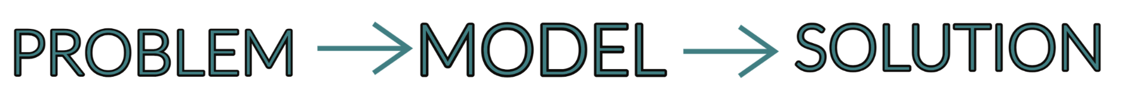
BUSINESS UNDERSTANDING
In summary, the task can be represented as follows:

Slide 5
DATA PREPARATION
Python was utilized for data preparation, as well as pandas library specifically.
Data was cleaned and prepared for analyzation.
Method of Approach:
Look for null or missing values.
Identify values that are improbable.
Create visualizations of the data.

Slide 6
EXPLORATORY DATA ANALYSIS
We analyzed the demographic data characteristics include gender, race, ethnicity, region, age bracket, and iodine indicator.
The data variables are represented via stacked bars and correlation heatmaps.

Slide 7
EXPLORATORY DATA ANALYSIS
Some demographic observations include the following:
More significant number of female participants.
There are more persistent than non-persistent participants, indicating an imbalanced dataset.
The primary racial demographic of the dataset is caucasian (non-hispanic).
Most of the participants are 75 and older.
‘Below 55’ age bracket is the least represented age demographic.

Slide 8
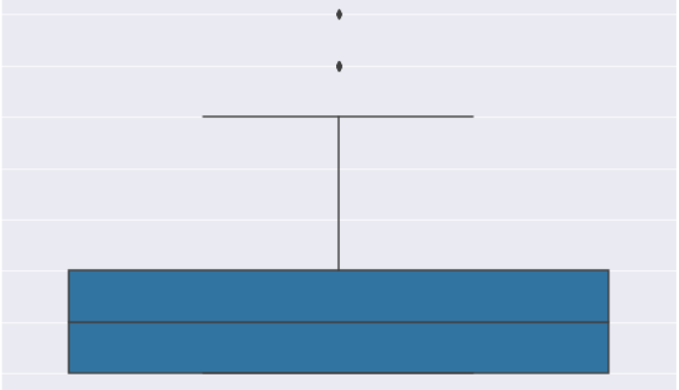
Outlier Test

Slide 9
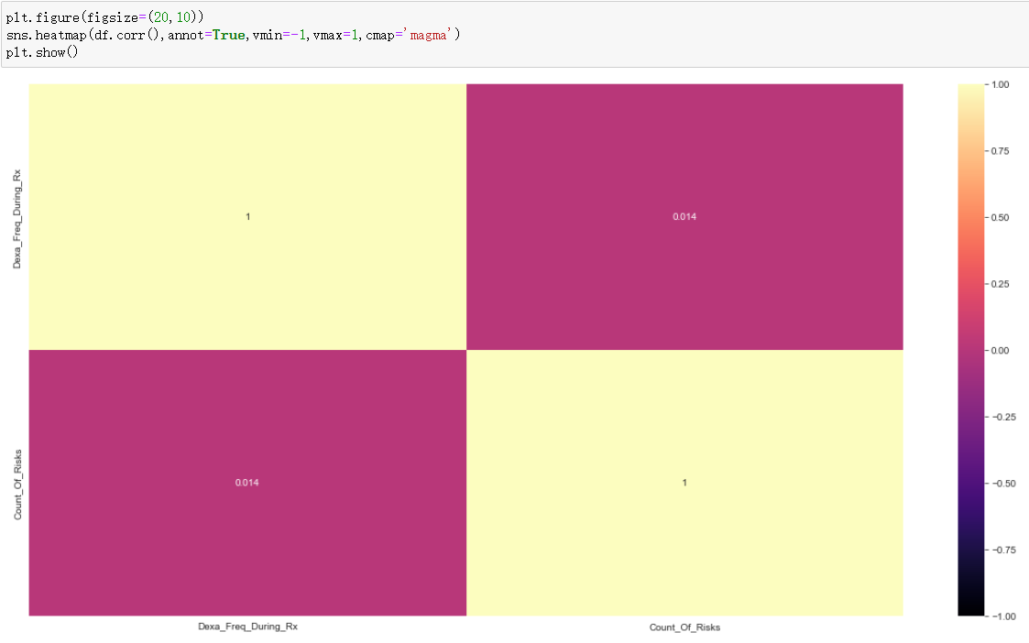
Heatmap

Slide 10
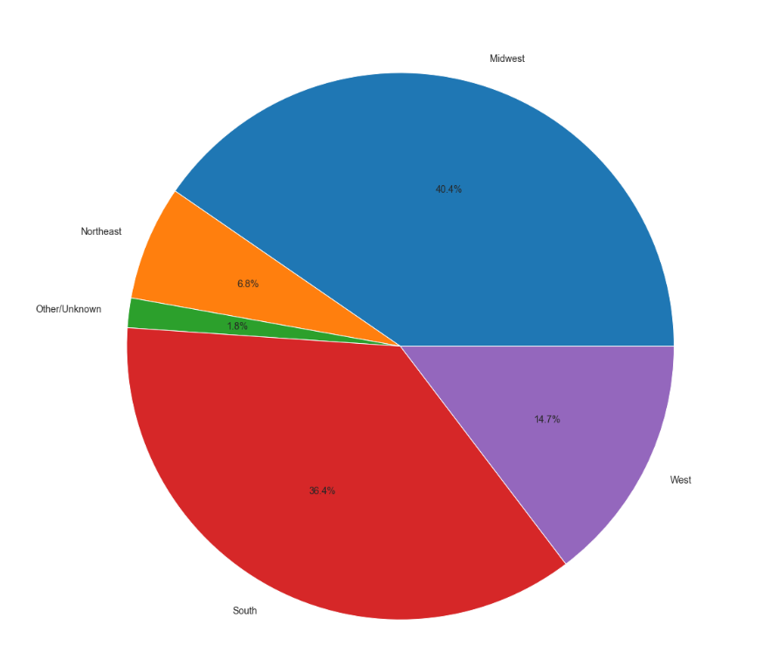
Data Amount by Region

Slide 11
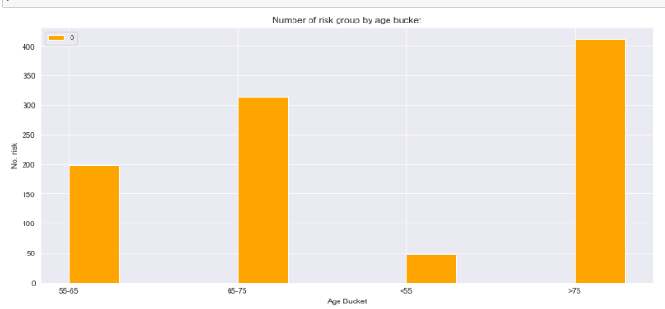
Risk Count by Different Age Group

Slide 12
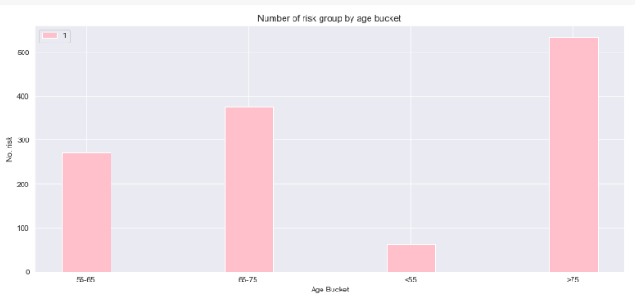
Number of Risk Group by Age Bucket

Slide 13
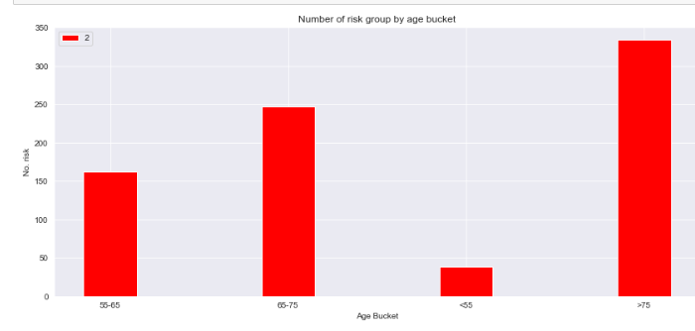
As a result, the count of risk doesn’t show much difference in different age group.

Slide 14
Conclusion
Out of the many factors that may affect a patient’s persistency to a drug, having risks, being of a certain race, ethnicity, age group, and the specialty of the HCP have the strongest effect on a patient’s persistency towards a drug.
Now that the factors have been identified, we will be able to use a model to create an automated process of which can predict if a drug would be persistent on a patient or not. The random forest classifier model would be the best one to use in this scenario for predicting whether or not a patient would have persistency with a drug.

Slide 15
Thank You

